Slide 1
The guide
Erin Nishimura

Slide 2
The advice
think of each main noun as a character
Avoid abstract nouns
Avoid complex compound nouns (unless appropriate for the audience)
think of each main verb as a plot
Use action verbs
main noun and main verb go near the beginning of the sentence
main noun and the main verb go close together
break up complex sentences into bite size pieces
shorten sentences by removing extra words

Slide 3
The technique
Underline the main noun
Double underline the main verb
Is the main noun the real “character” of the sentence?
Is the main verb the real “plot” of the sentence?
How far away are they?

Slide 4
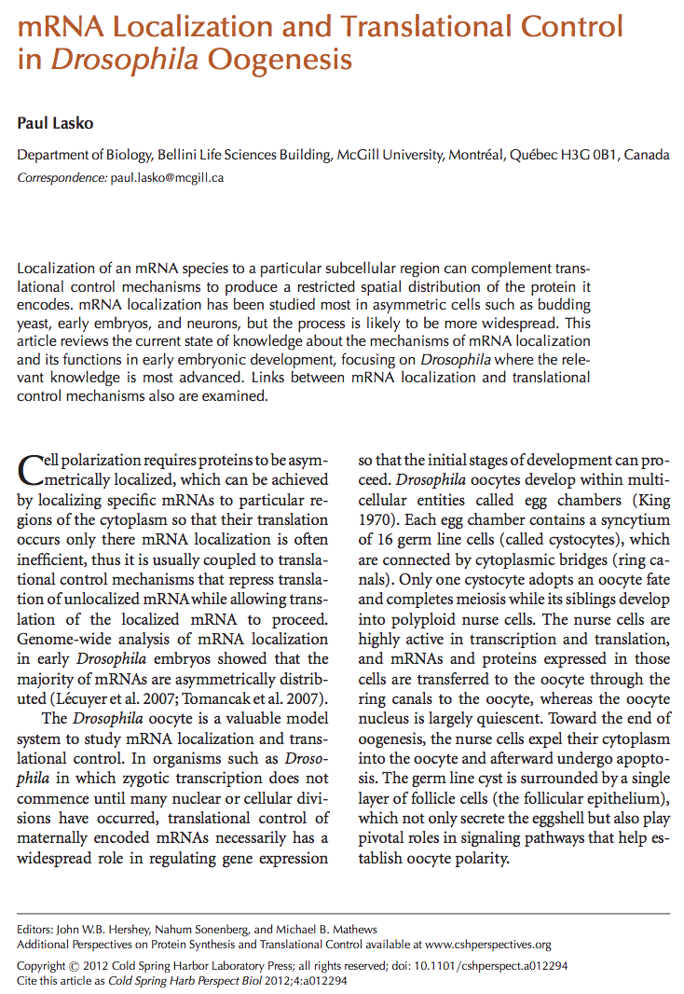
The review

Slide 5
Example edits from Lasko 2012
Original
Re-write
“Transport of many mRNAs, including grk, bcd, and osk, from the nurse cells to the oocyte occurs prior to overall cytoplasmic transfer, and proceeds via minus end-directed transport on the microtubule cytoskeleton that is driven by the dynein motor complex (Clark et al. 2007).” – Lasko 2012

Slide 6
Example edits from Lasko 2012
Original
Re-write
“Transport of many mRNAs, including grk, bcd, and osk, from the nurse cells to the oocyte occurs prior to overall cytoplasmic transfer, and proceeds via minus end-directed transport on the microtubule cytoskeleton that is driven by the dynein motor complex (Clark et al. 2007).” – Lasko 2012
44 words
Main noun
Main verb
The dynein motor complex drives mRNAs such as grk, bcd, and osk out of nurse cells and into oocytes via minus end-directed transport on microtubules. This happens prior to transporting other cellular components (Clark et al. 2007).
25 + 13 = 38

Slide 7
old information first, new information second
Original
Re-write
“Activators of translation of specific mRNAs have not been identified as frequently as repressors, and less is known about their function.” – Lasko 2012

Slide 8
old information first, new information second
Original
Re-write
“Activators of translation of specific mRNAs have not been identified as frequently as repressors, and less is known about their function.” – Lasko 2012
Target-specific repressors of translation are relatively common and well described. However, target-specific activators of translation are rarer and less well understood.
OR
Unlike target-specific repressors of translation, activators remain relatively understudied.

