Slide 1
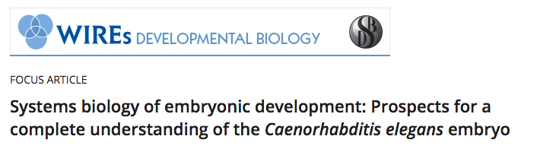
Wiley Interdiscip Rev Dev Biol. 2018 May;7(3):e314
| CAENORHABDITIS ELEGANS – AN ANIMAL MODEL ORGANISM THAT INTRODUCED THE CONCEPT OF COMPLETENESS
| A FRAMEWORK FOR DEVELOPMENTAL SYSTEMS BIOLOGY
Identifying the parts list.
Modeling, prediction and perturbation
| RATIONALE FOR A COMPREHENSIVE APPROACH
| IDENTIFYING THE PARTS LIST: LARGE-SCALE IMAGING
| IDENTIFYING THE PARTS LIST: GENOME-SCALE EXPRESSION PROFILING
| SINGLE CELL TRANSCRIPTOMICS
| PROSPECTS FOR COMPLETING THE PARTS LIST FOR ALL CELLS AND ALL GENES
| APPLICATIONS OF THE PARTS LIST TO INFERRING REGULATORY PATHWAYS AND MECHANISMS
8.1 | Experimental testing of regulatory networks – Top-down approaches
8.2 | Experimental testing of regulatory networks – Bottom-up approaches
9 | CONCLUSIONS

Slide 2
I. Elementary Rules of Usage
2. In a series of three or more terms with a single conjunction, usage a comma after each term except the last.
Thus write,
red, white, and blue
He opened a letter, read it, and made a note of its contents.
3. Enclose parenthetic expressions between commas
The best way to see a country, unless you are pressed for time, is to travel on foot.
2 | A FRAMEWORK FOR DEVELOPMENTAL SYSTEMS BIOLOGY
Transition between C. elegans ”completeness” and idea of systems approach. Clarify thesis: define “parts list”, basis for computational modeling, and testing with specific experiments.
1. Identifying the parts list.
Talk about cell lineages, fates. Listing of genomics method and application. (I.e. single-cell RNA-seq). …
Harder to accurately measure protein level, nuclear localization, phorphorylation (sic) states post translational reg…
However, a systematic catalog of messenger RNA (mRNA) levels will be an important resource to identify both transcriptional regulators and genes involved in other aspects of embryonic cell function.
2. Modeling, prediction and perturbation.
A “complete” understanding of gene regulation during development would include determining the dependencies of gene expression on TFs and cis-regulatory sequences, chromatin state, protein-protein interactions, DNA replication timing, and other genomic features. ﻿Significant existing resources exist …
conjunction

Slide 3
Long sentence:
8.1 | Experimental testing of regulatory networks–Top-down approaches
A general reverse genetics strategy to define regulatory networks queries the developmental lineage from “top down” by removing a regulator expressed in a particular lineage by using mutants or RNAi, and then assaying the resulting changes in later gene expression and cell fate.
Broken down:
A general reverse genetics strategy to define regulatory networks queries
… the developmental lineage from “top down” by removing a regulator expressed in a particular lineage by using mutants or RNAi, and then assaying the resulting changes in later gene expression and cell fate.

Slide 4
A general reverse genetics strategy to define regulatory networks queries
There are general reverse genetics strategies to define regulatory networks. A common such approach queries...
… the developmental lineage from “top down” by removing a regulator expressed in a particular lineage by using mutants or RNAi, and then assaying the resulting changes in later gene expression and cell fate.

