Slide 1
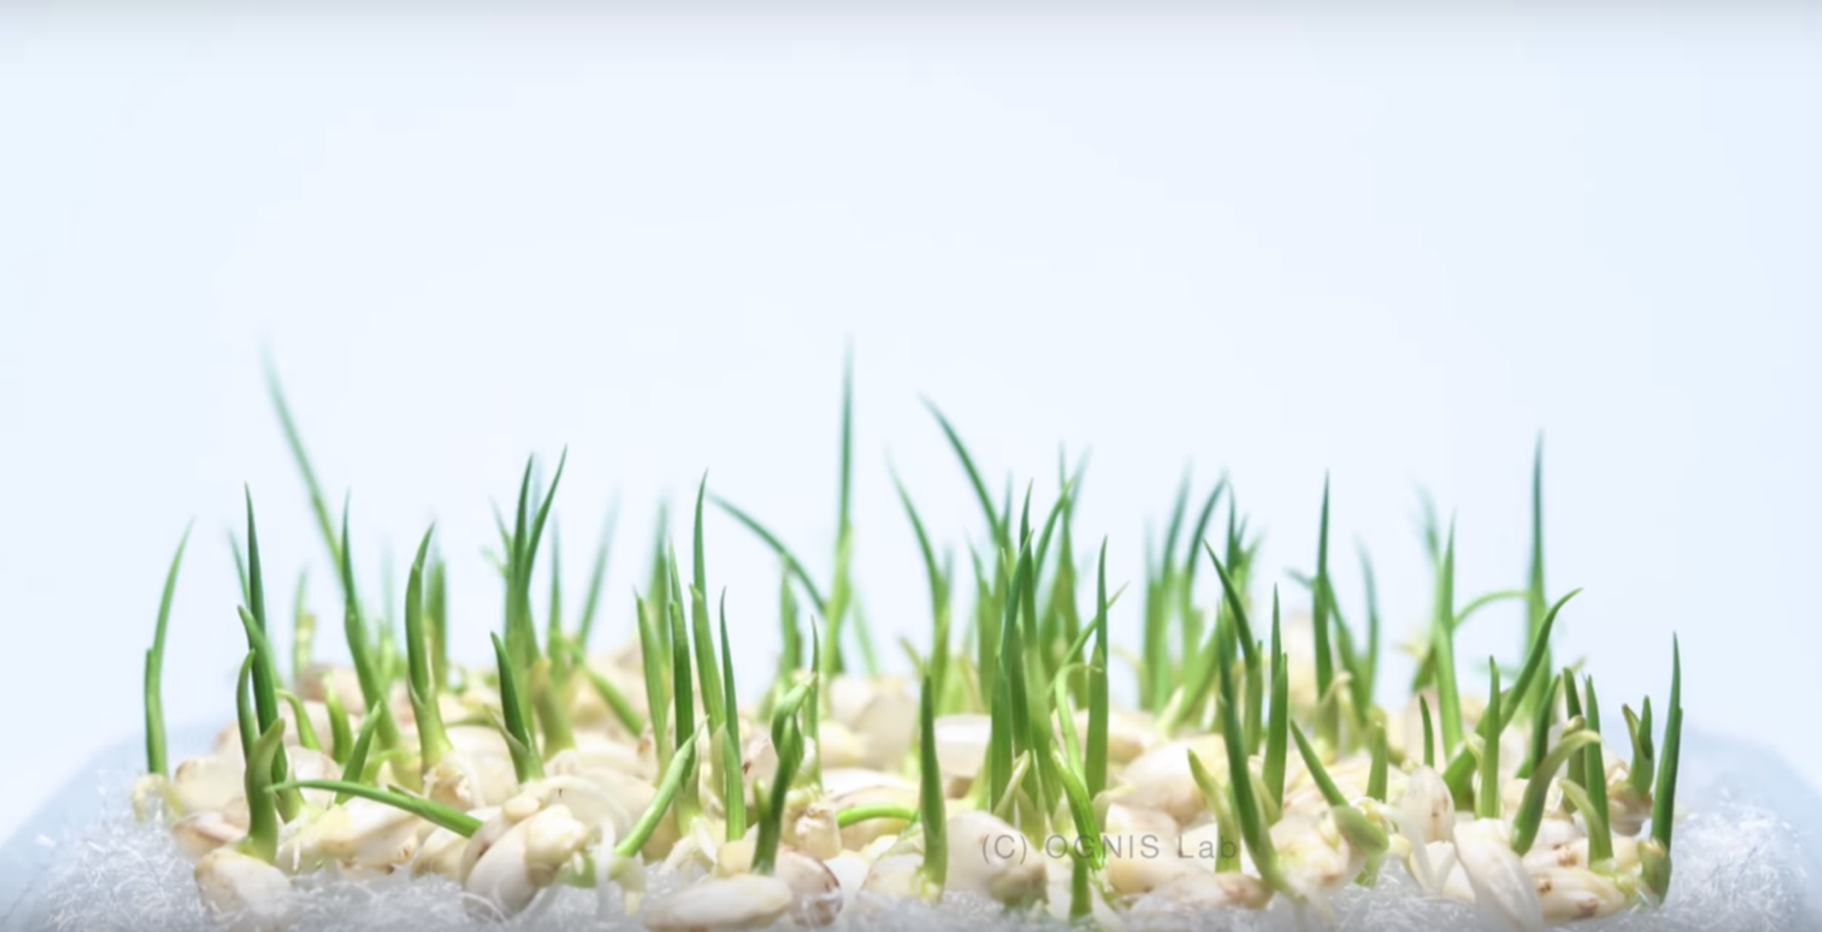
PCA: Principle Component Analysis
Seré Williams
August 9, 2019

Slide 2
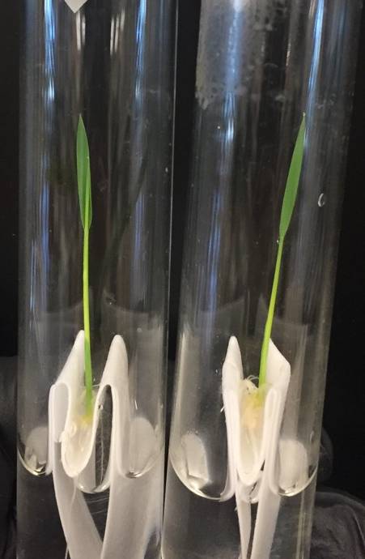
RNA-seq of WT and Ossr1 seedlings
Two lines
WT
Ossr1
WT
Ossr1

Slide 3
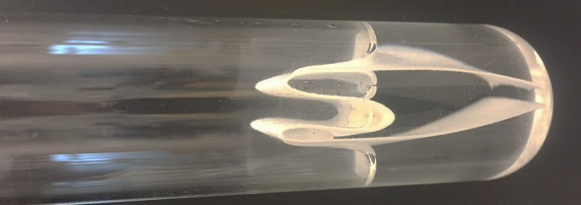
RNA-seq of WT and Ossr1 seedlings:
Experimental Design
Two lines
WT
Ossr1
WT
Ossr1
WT
Ossr1

Slide 4
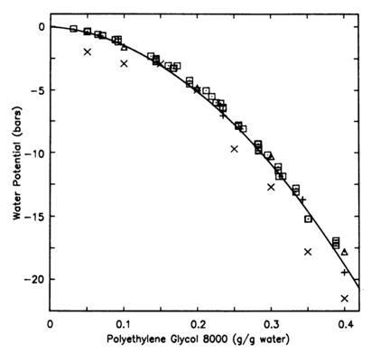
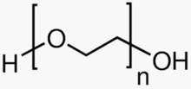
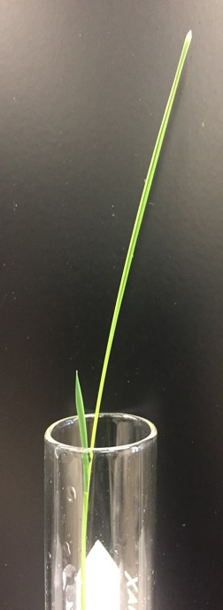
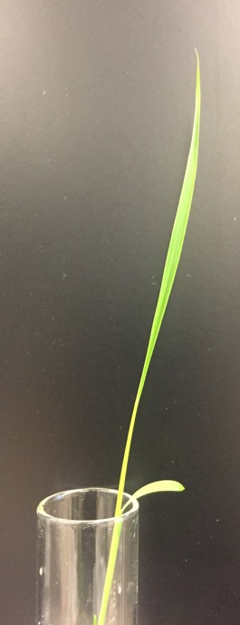
Michel, Plant Phys. 1983
Polyethylene glycol
RNA-seq of WT and Ossr1 seedlings:
Experimental Design
Two lines
WT
Ossr1
Control
PEG
Drought-stress
treatment
WT
Ossr1
WT
Ossr1

Slide 5
Michel, Plant Phys. 1983
Polyethylene glycol
RNA-seq of WT and Ossr1 seedlings:
Experimental Design
40% PEG 8000 = -18 bar
Two lines
WT
Ossr1
Control
PEG
Drought-stress
treatment
WT
Ossr1
WT
Ossr1

Slide 6
RNA-seq of WT and Ossr1 seedlings: Experimental Design
55 WT seeds
55 Ossr1 seeds
7 discarded
7 discarded
48 seedlings
48 seedlings
24 treated
24 control
24 treated
24 control
12 - 1hr
12 - 3hr
12 - 1hr
12 - 3hr
12 - 1hr
12 - 3hr
12 - 1hr
12 - 3hr
3
3
3
3
3
3
3
3
3
3
3
3
3
3
3
3
3
3
3
3
3
3
3
3
3
3
3
3
3
3
3
3
Example:
WT, Treated, 3hr, Bio Rep 1
WT_T_3.1

Slide 7
RNA-seq of WT and Ossr1 seedlings: Confirmation of samples
WT
Ossr1
M
Control
PEG
Control
PEG
NT
1hr
GAPDH, 329bp
250bp
3hr
250bp
1kb
1hr
OsSR1, 732bp
1kb
3hr
250bp
1hr
DREB1C, 106bp
250bp
3hr

Slide 8
RNA-seq of WT and Ossr1 seedlings: Confirmation of samples
WT
Ossr1
M
Control
PEG
Control
PEG
NT
1hr
GAPDH, 329bp
250bp
3hr
250bp
1kb
1hr
OsSR1, 732bp
1kb
3hr
250bp
1hr
DREB1C, 106bp
250bp
3hr

Slide 9
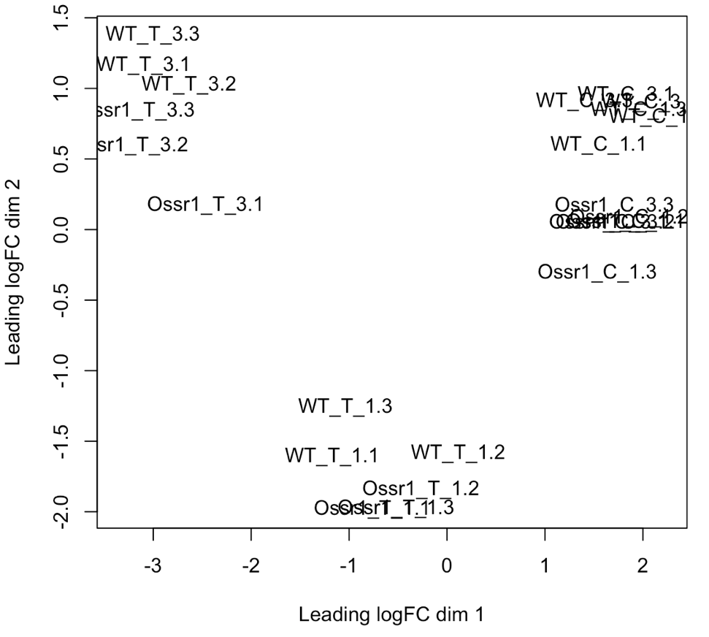
RNA-seq of WT and Ossr1 seedlings: Multi-dimensional scaling plot

Slide 10
RNA-seq of WT and Ossr1 seedlings: Multi-dimensional scaling plot
All control

Slide 11
RNA-seq of WT and Ossr1 seedlings: Multi-dimensional scaling plot
WT
All control
Ossr1

Slide 12
RNA-seq of WT and Ossr1 seedlings: Multi-dimensional scaling plot
WT
All treated, 3hr
All control
Ossr1
All treated, 1hr

Slide 13
RNA-seq of WT and Ossr1 seedlings: Multi-dimensional scaling plot
WT
All treated, 3hr
All control
Ossr1
All treated, 1hr

Slide 14
StatQuest
https://statquest.org/
https://www.youtube.com/watch?v=HMOI_lkzW08&feature=youtu.be

Slide 15
Apply it
“Here we characterize genetic variation in a sample of 3,000 European individuals genotyped at over half a million variable DNA sites in the human genome. ”

Slide 16
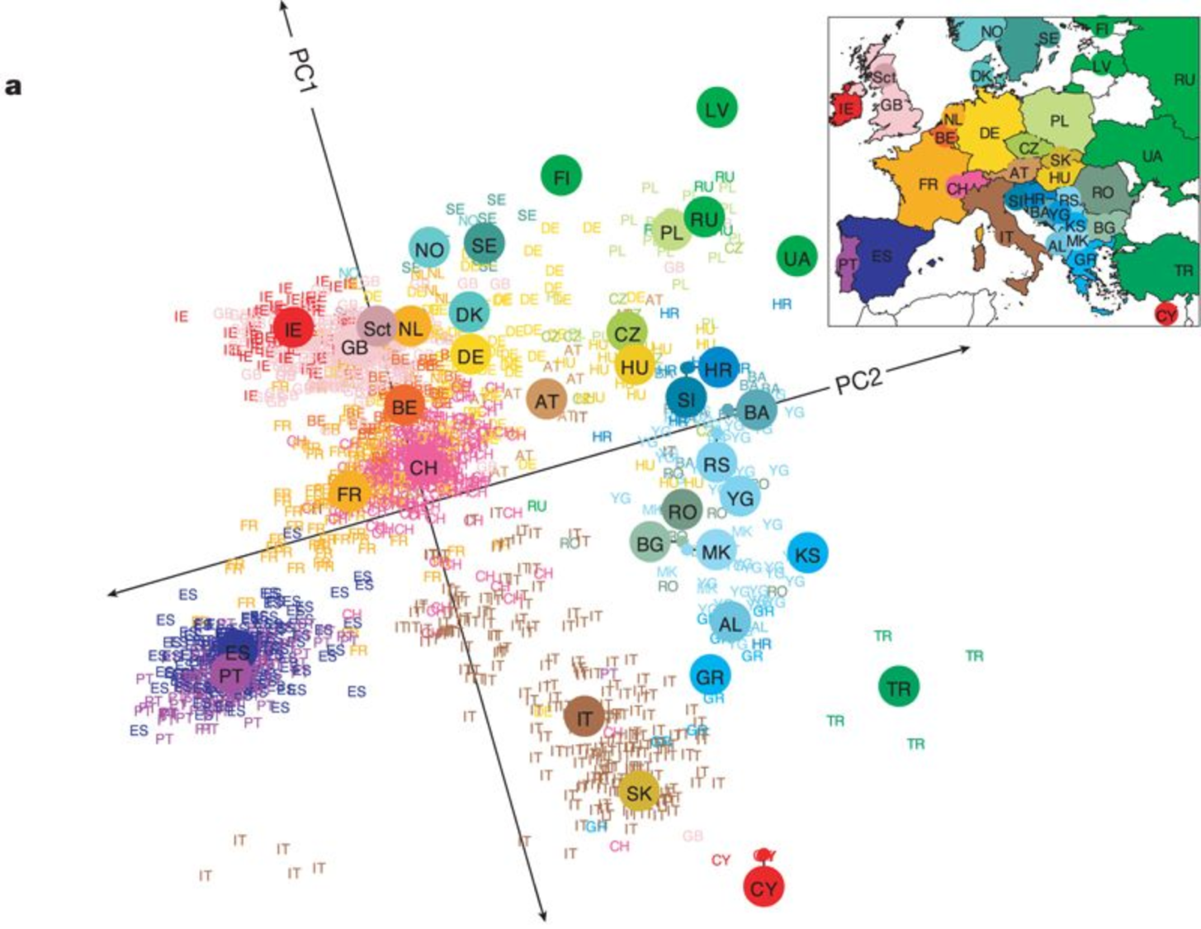
Apply it
Novembre et al., Nature 2008

Slide 17
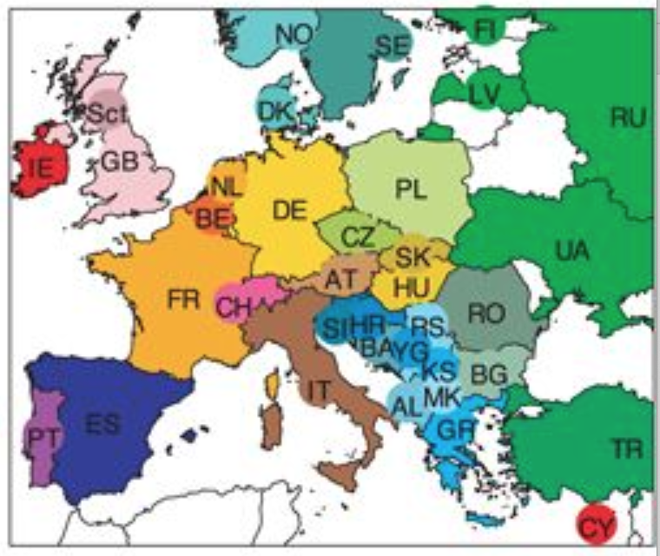
Apply it
Novembre et al., Nature 2008

Slide 18
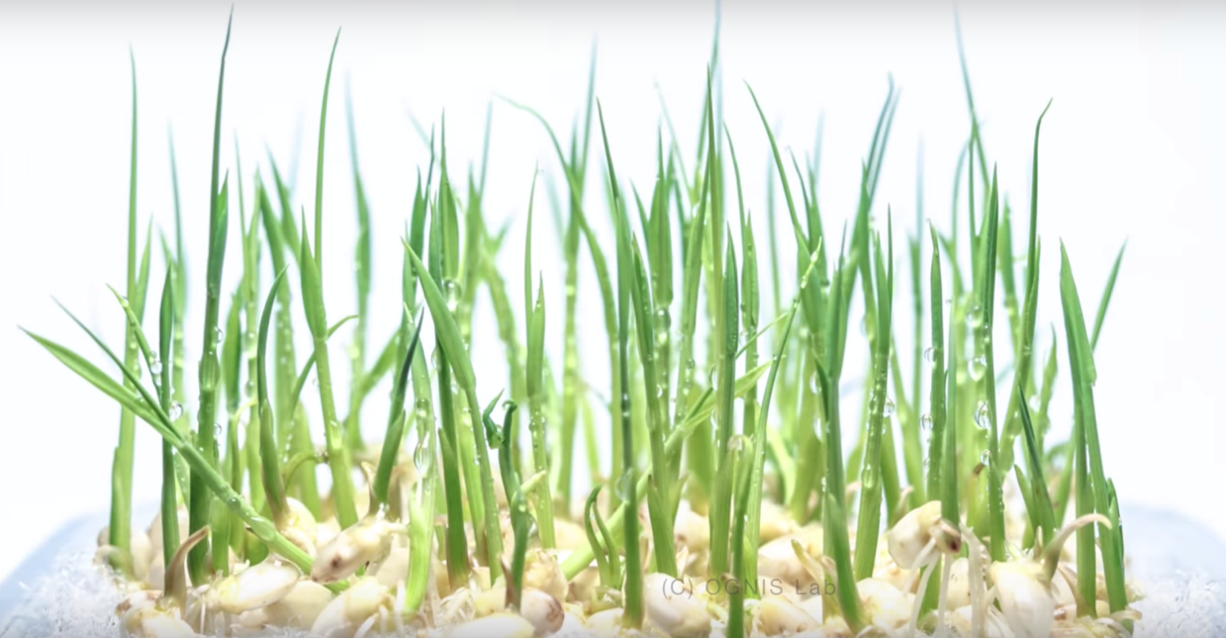
Thank you
https://www.youtube.com/watch?v=i9RQX1oGtEs

Slide 19
Questions?
https://www.youtube.com/watch?v=i9RQX1oGtEs

