Slide 1
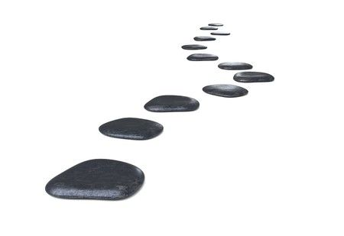
A topic is not an argument (but you need both)
Erika Szymanski
Nishimura lab summer science writing workshop
Colorado State University 2023

Slide 2
Investigates how scientific knowledge, technologies, and innovations are constructed, and how they act and interact in society
Investigates social, historical, philosophical, economic, and cultural dimensions of science and technology
Science and technology studies (STS)
Notes:
2
Macquarie

Slide 3
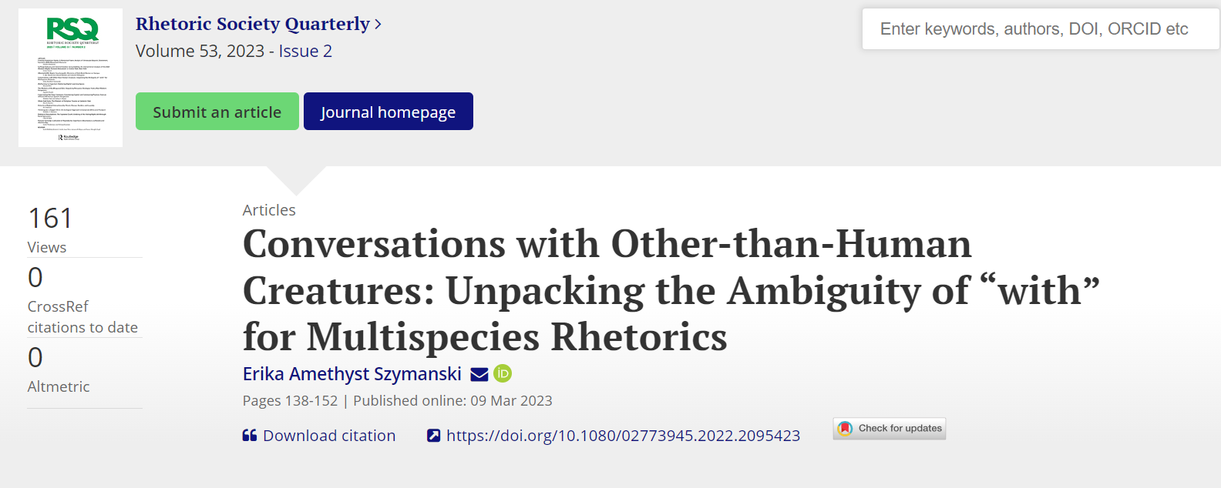
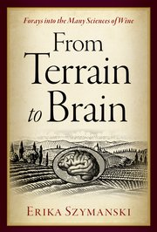
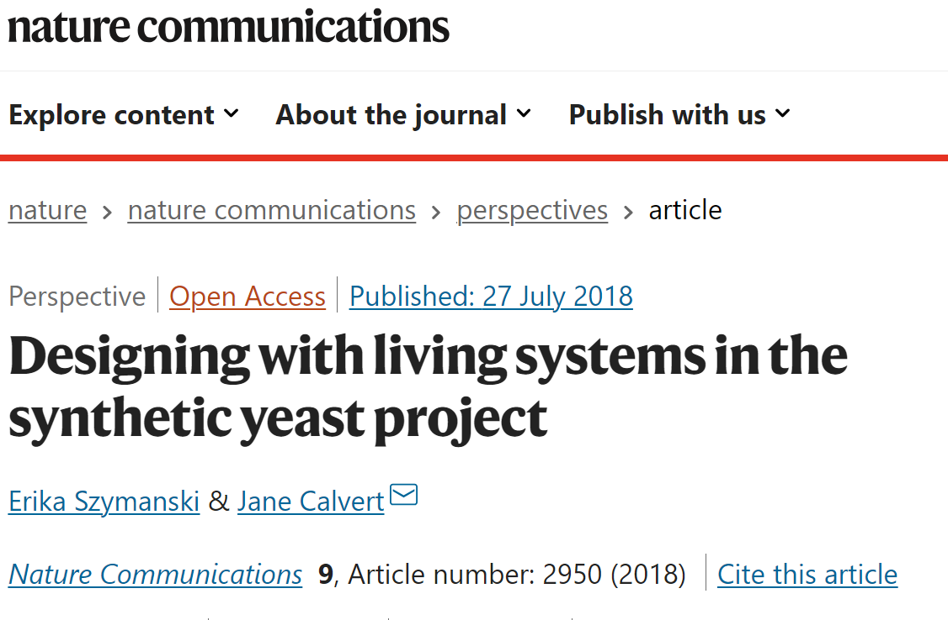
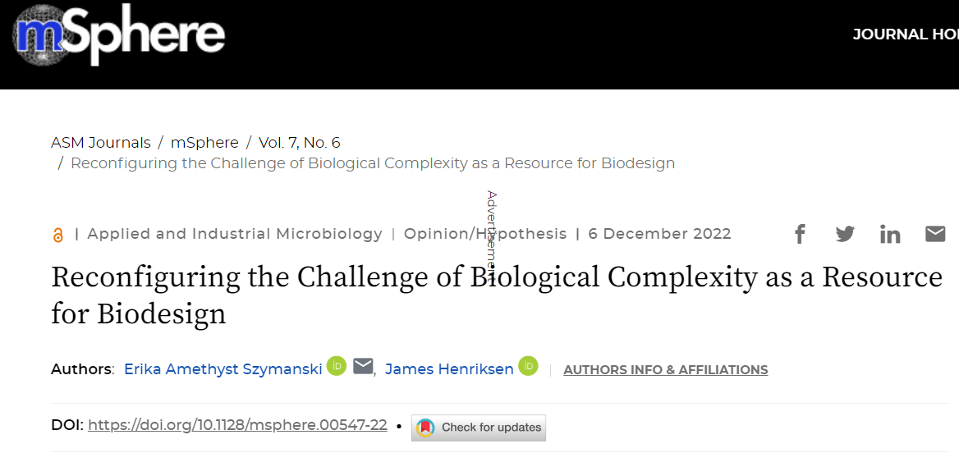

Slide 4
3 minutes two write 2 sentences:
What is your research about and why does it matter?

Slide 5
Topic
≠
Question
≠
Argument

Slide 6
A topic isn’t an argument, and you’re almost always writing an argument.
Your argument is always a function of your audience and your purpose.
Being specific about your argument and its structure will help you organize whatever you’re writing.

Slide 7
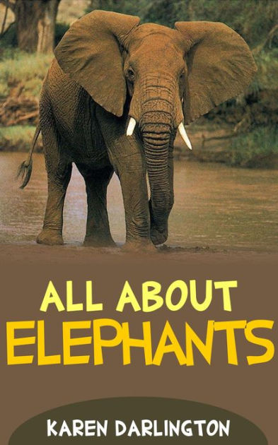
A report aims to convey information with no specific objective beyond that.
A report is essentially a list of facts or observations.
Whatever you’re writing, you’re almost certainly not writing a report.

Slide 8
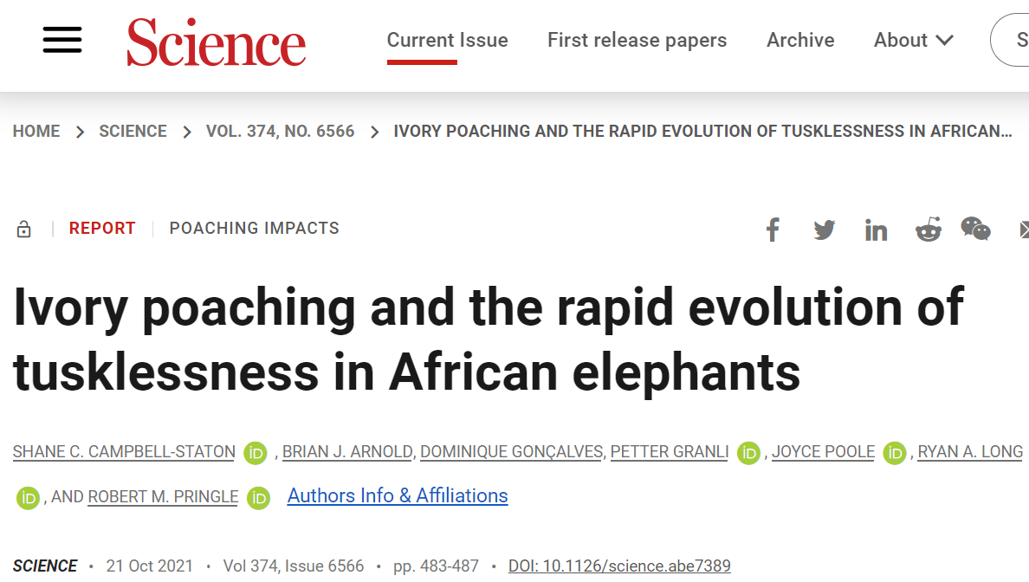
An argument makes a point.
An argument is a logical proposition or set of logical propositions.
Research articles, reviews, grant proposals, & popular articles (& virtually everything else) are arguments.

Slide 9
Topic: elephants, elephant genetics, impacts of war on animal evolution
Argument: Because of intense hunting during the Mozambique civil war, the prevalence of an X-linked genetic trait for tusklessness has increased among the region’s African elephants over just a few decades, demonstrating how civil unrest can rapidly alter animal populations.

Slide 10
Rhetorician
Rhetoric
Strategic language use
(Words as tools)

Slide 11
Aristotelian The art of persuasion
rhetoric
Contemporary Strategic communication
Rhetoric (the art of communicating so as to be taken into account)

Slide 12
So what?

Slide 13
Topic: elephants, elephant genetics, impacts of war on animal evolution
Argument: Because of intense hunting during the Mozambique civil war, the prevalence of an X-linked genetic trait for tusklessness has increased among the region’s African elephants over just a few decades, demonstrating how civil unrest can rapidly alter animal populations.

Slide 14
This may seem obvious, but:
…losing sight of the argument is easy when you’re caught up in a complex writing task such as writing a lit review.
…your argument and its audience should guide the choices you make throughout your writing.
…you need to think them through at the very beginning of the process.
…they remain true no matter what you’re writing.
Notes:
All of this is as true for presenting to scientific (and other) audiences as to anyone, but it’s far easier not to think consciously about them when you and your audience are likely to care about your research for similar reasons, i.e. when they’re your scientific peers.

Slide 15
The same rhetorical principles apply across all communication contexts, and they always center audience and purpose.
Central principle

Slide 16
There is no such thing as “the general public” or a “general audience.”
Central principle

Slide 17
Writing is about constructing relationships among you as an author, your audience, and your argument.
Audience
Author
Message
Central principle
u
s
e
g
i
t
d
A
e
h
c
e
n
s
u
o
A
a
e
M
e
u

Slide 18
Forensic
Epideictic
Deliberative
Past: what happened?
Present: what should we think?
Future: what should we do?
Peer-reviewed research reports
Popular science
Industry, policy, & stakeholder communication
Readers are evaluators & adjudicators of scientific knowledge
Readers are evaluating & forming opinions about science in wider society
Readers are deciding whether & how science might be useful for their own purposes

Slide 19
You always have an argument to make no matter where you are in your research (even if you haven’t yet collected any data).
Central principle

Slide 21
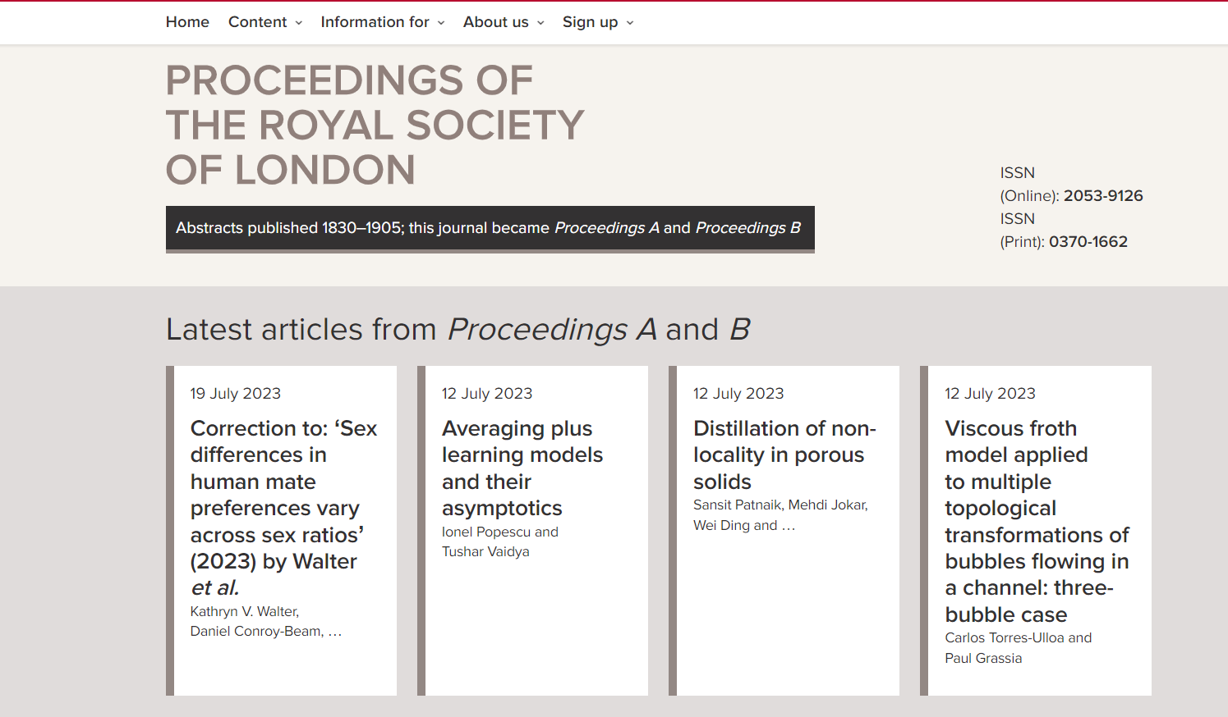

Slide 22
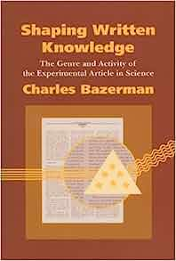

Slide 23
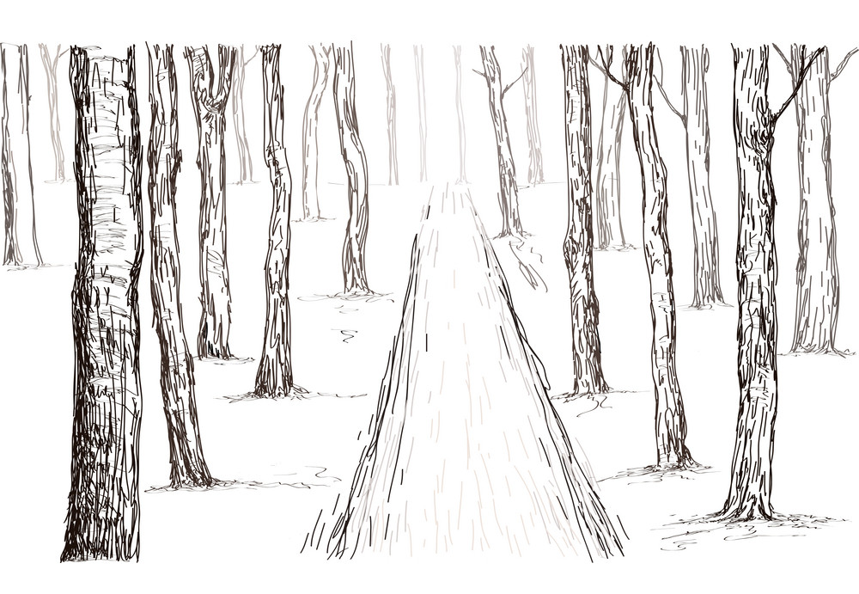
All science writing is storytelling (you’re always selecting and sequencing events)
Central principle

Slide 24
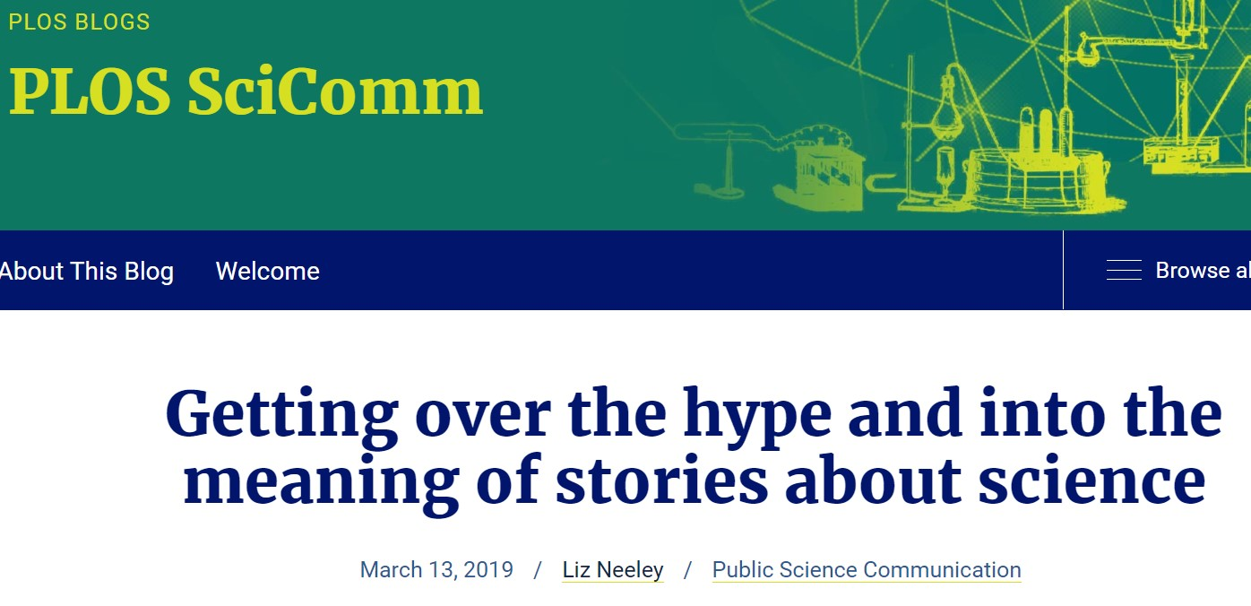
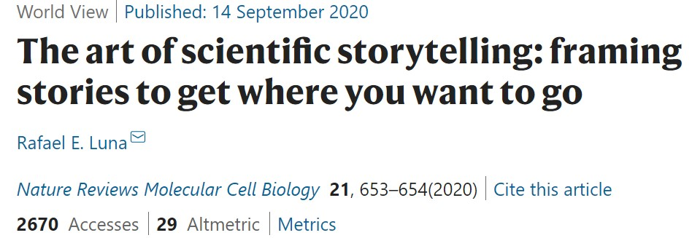
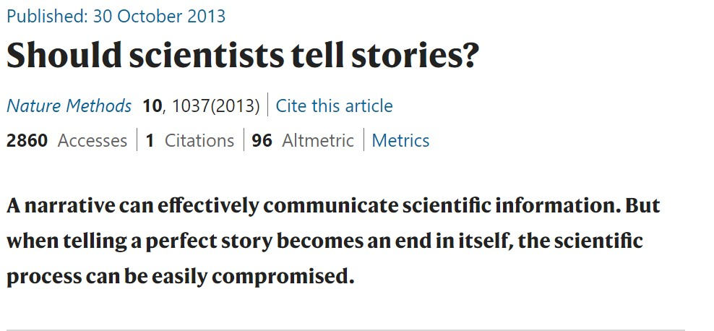
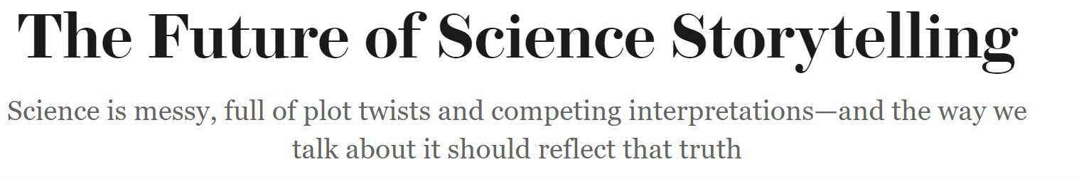

Slide 25
evidence → warrants → claims
GMOs are safe to eat, therefore consumers should accept them.
Evidence: GMOs are safe to eat.
Claim: Consumers should accept GMOs.
Warrant: Consumers should accept things that are safe to eat (but consumers may object to GMOs for other reasons)

Slide 26
Beginning: Where do you meet your readers? What larger topic interests both you and them? In what question do you want to interest them?
End: Where do you lead your readers? What new conclusion do you show them that respond to the question that they and you share?
Middle: What kinds of details (support for which warrants) do you need to lead your readers from where you start to your conclusion? Given their relationship to you and the topic, what kinds of warrants do you need to address?

Slide 27
Your (now logically evident) conclusion
Explanation of & support for your warrants
Common ground where you and your reader can meet

Slide 28
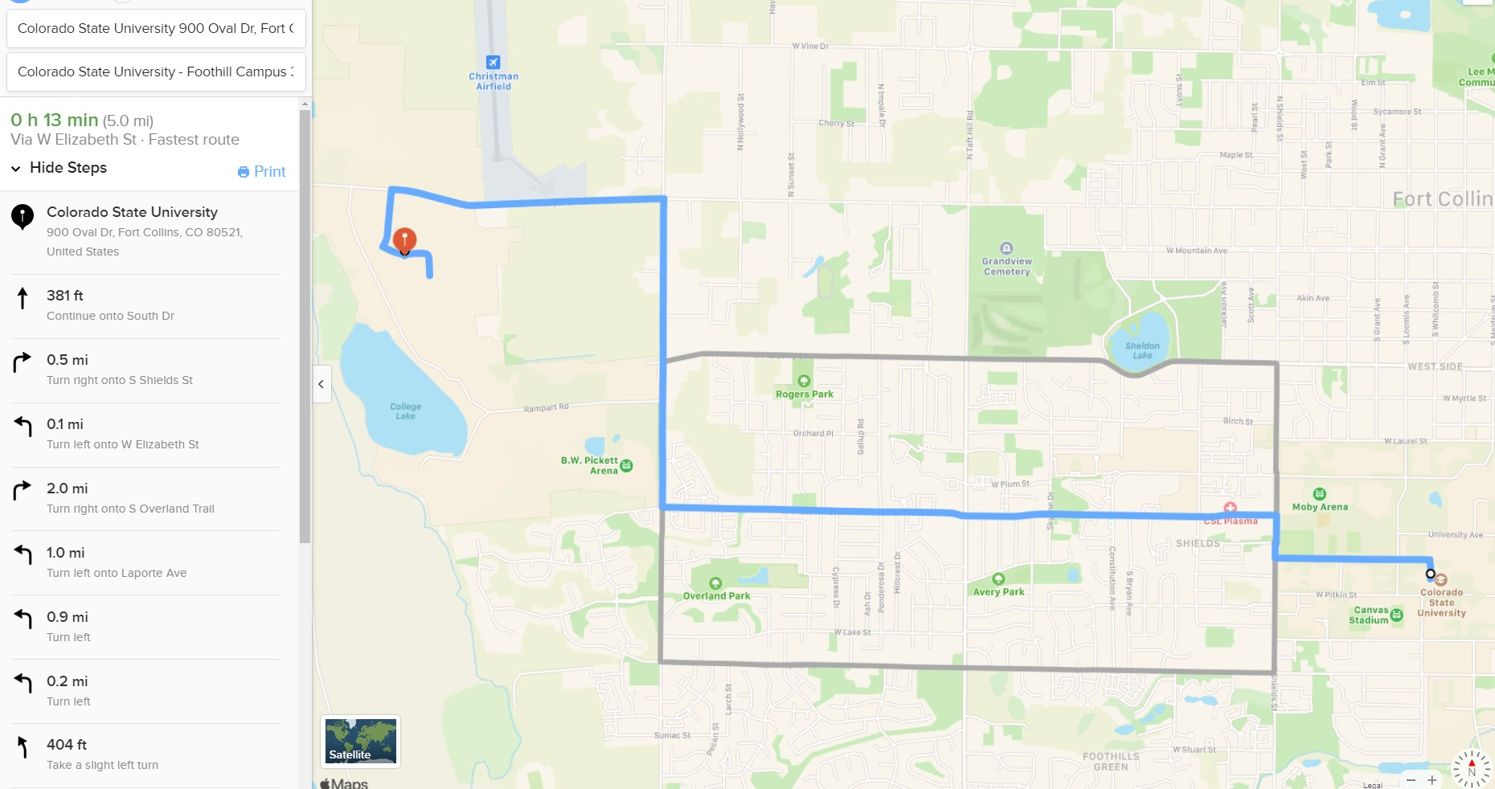

Slide 29
Structure of the argument of the paper I submitted over the weekend
1. Microbial communities can only ever be observed partially and indirectly, so we have to imagine what their internal structure might be.
2. Those expectations are structured by metaphors, or ideas about what microbiomes are like.
3. Metaphors are therefore important design tools for constructing microbial consortia-based biotechnologies.
4. Researchers in this area should be aware of the work metaphors do in structuring their analyses, and may need to experiment with them deliberately.

Slide 30
So what?
Science writing is about making strategic choices to serve your purpose in a particular context

Slide 31
“Transparent language” or “neutral language” doesn’t exist.
Central principle

Slide 32
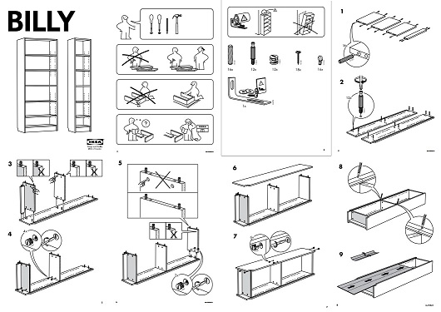

Slide 33
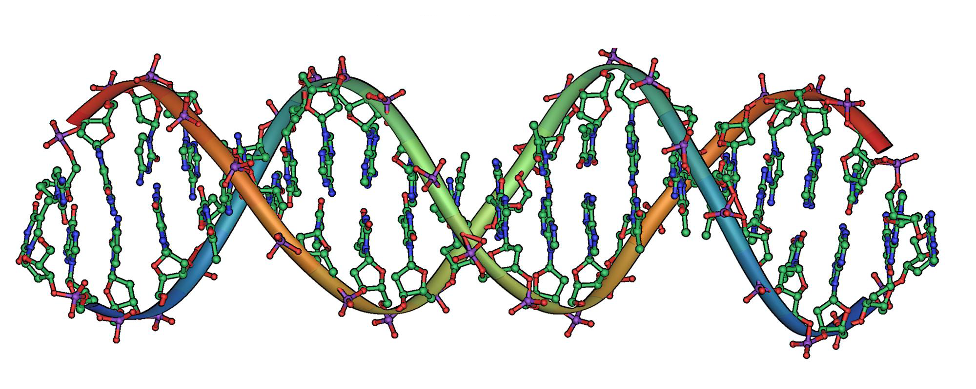
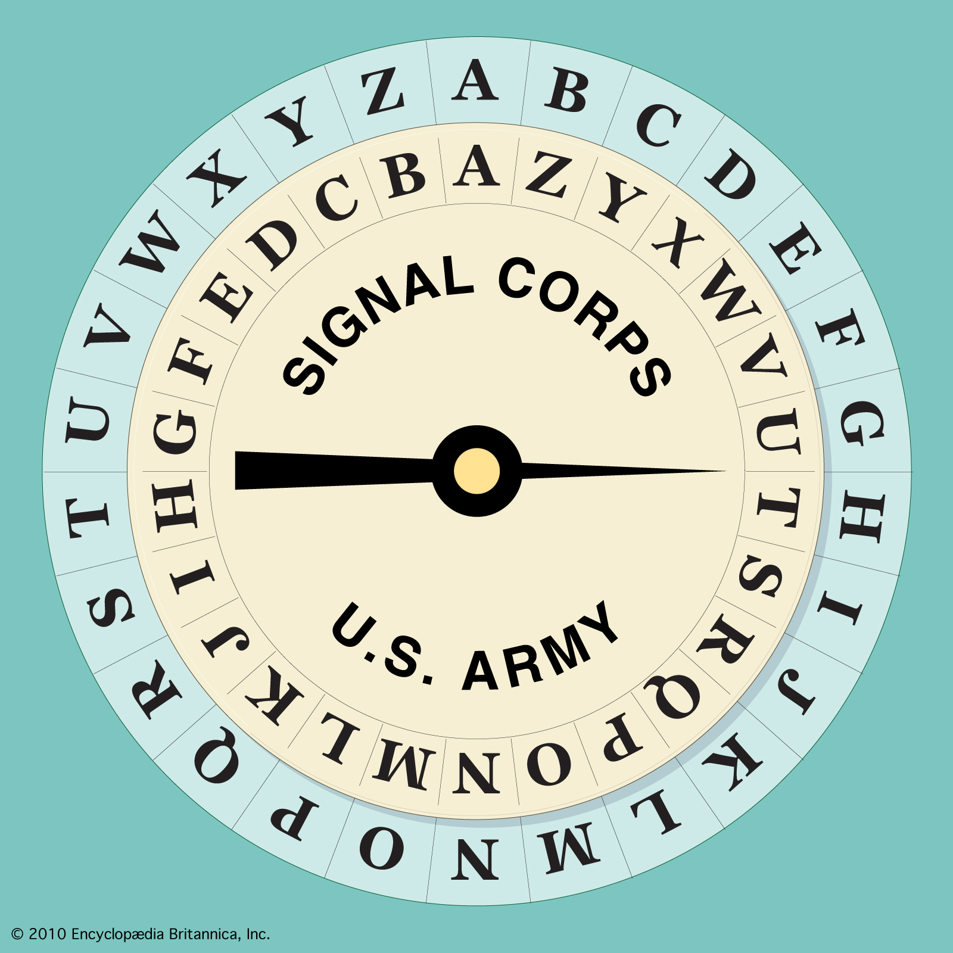
metaphor
Source domain
Target domain
frame or lens for thinking & working
Read, write, encode, decode

Slide 34
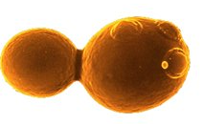
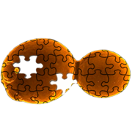
011101001100111011011101001011101001100111011011101001100101110100101110
011101001100111011011101001011101001101001101001101001
Operating system
Chassis
Coworker

Slide 35
Words involve choices.
Choices involve values.

Slide 36
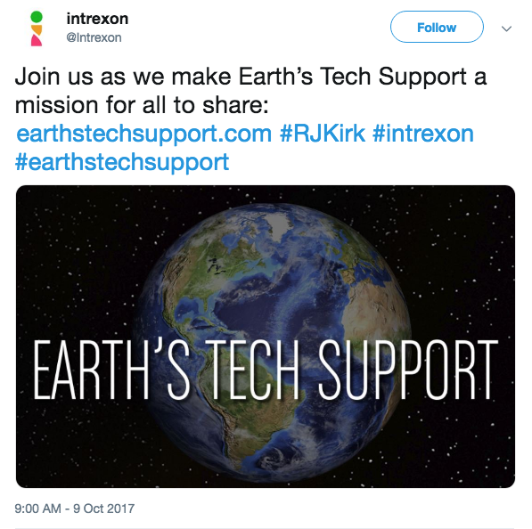

Slide 37




Thank you.
Erika Szymanski
Erika.szymanski@colostate.edu

