Slide 1
Scientific writing in the classroom
Drew Tonsager
2023 Summer Science Writing Workshop

Slide 2
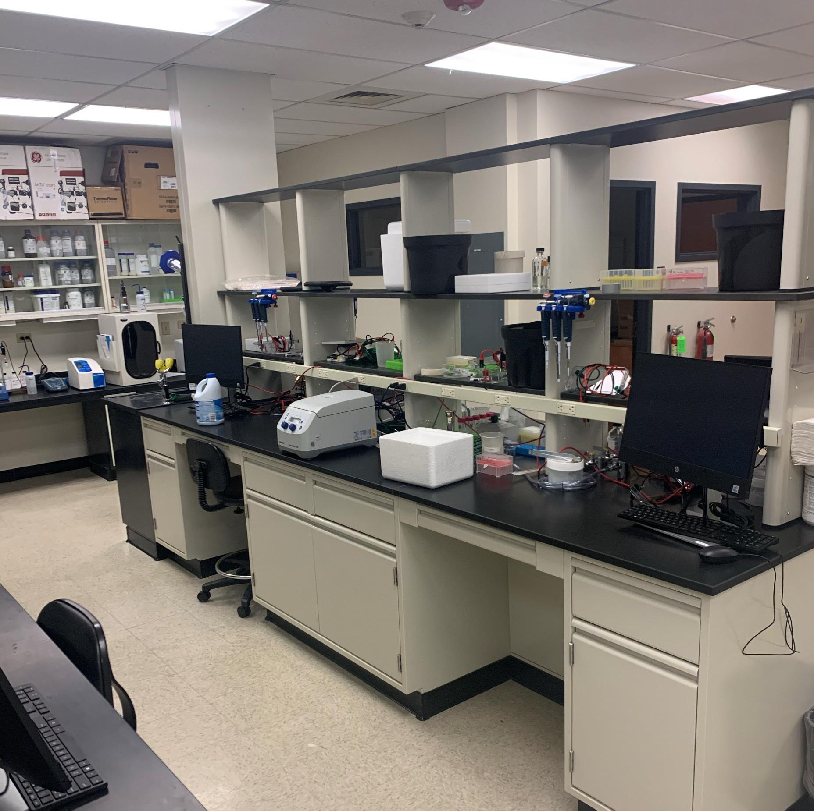
An eye-opening experience while teaching BC406B…
Working with my mentor Laurie Stargell, I developed the curriculum for BC406B, an eight-week research-based laboratory course for undergraduates
I wrote my own quiz/exam questions (for better or for worse)

Slide 3
I wrote some horrendous questions at first!
Drew performed a PCI extraction and unfortunately failed to get a PCR amplicon from his sample. However, he clearly had a visible, white precipitate present in the bottom of his tube. Explain what the white substance in the sample might be (other than DNA).

Slide 4
What went wrong?
My language wasn’t clear, concise, or consistent!
I realized later that I needed to assess student knowledge of concepts before asking them to apply the knowledge. (More on this later!)

Slide 5
Good questions are clear
Clear
Avoid jargon or uncommon acronyms as much as possible
Avoid ambiguity or double meanings
Notes:
Technical language or high levels of detail can be a barrier to student learning.

Slide 6
Good questions are concise
Concise
Write short and simple sentences
Eliminate unnecessary phrases and redundancies

Slide 7
Good questions are consistent
Consistent
Assess students using the same words used when the concept was taught (constrained language)
If terms used are inconsistent, learners may think different terms mean different things

Slide 8
Let’s revisit this question….
Drew performed a PCI extraction and unfortunately failed to get a PCR amplicon from his sample. However, he clearly had a visible, white precipitate present in the bottom of his tube. Explain what the white substance in the sample might be (other than DNA).
Drew extracted nucleic acids with phenol:chloroform but failed to amplify DNA from his sample. However, his sample contained a white precipitate. What might this precipitate be (other than DNA)?

Slide 9
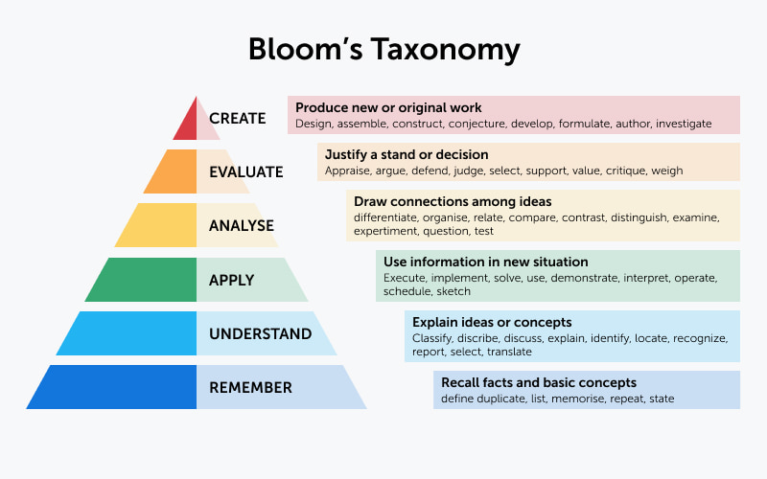
Consider applying Bloom’s Taxonomy to order learning outcome and build upon learning
Higher level processes build upon lower-level processes
If the lower-level processes are not achieved, then the higher level one will be deficient

Slide 10
Remember involves recalling and recognizing concepts
The processes associated with understanding are defining, duplicating, listing, memorizing, and stating
Sample question frames:
What are the most spoken languages of Latin America?
What is the chemical formula for water?
Who was the first president of the United States?
“Before you can understand a concept, you must remember it”

Slide 11
Understand involves learners explaining a concept in their own words
The processes associated with understanding are interpreting, exemplifying, classifying, summarizing, inferring, comparing, and explaining
Sample question frames:
Describe Newton’s three laws of motion in your own words
Explain how sensory receptors in our brain detect stimuli
Distinguish mass versus weight
“To apply a concept, you must first understand it”

Slide 12
Apply involves using facts, ideas, and concepts in new contexts and situations
The processes associated with application are executing, implementing, solving, and demonstrating
Sample question frames:
Calculate the kinetic energy of a projectile
Determine the derivative of the following mathematical equation
Plot the data from your enzymatic reaction using the Lineweaver-Burke method

Slide 13
Analyze involves learners breaking down concepts and examining their relationships
The processes associated with analysis are differentiating, organizing, and attributing
Sample question frames:
Compare and contrast prokaryotic and eukaryotic cells
Illustrate how DNA code translates into RNA code
Identify the author’s point of view of an essay
“In order to evaluate a process, you must have analyzed it”

Slide 14
Evaluate involves learners making judgements on concepts
The processes associated with understanding are checking, defending, arguing and critiquing
Sample question frames:
In your opinion, is online piracy ethical?
Assess the environmental impact of coal mining
Would you expect an alanine substitution to alter the tertiary structure of this protein?
“To create an accurate conclusion, you must have completed a thorough evaluation”

Slide 15
Create involves learners demonstrating knowledge by
The processes associated with understanding are generating, planning, and producing
Sample question frames:
Design oligonucleotides to amplify the ampicillin resistance cassette from a plasmid
Compose the scientific name of an organism.
Develop a procedure to

Slide 16
Taken together…
Ensure your questions are clear, concise, and consistent
Assess students on lower-level processes (remember/understand) before higher-level processes (evaluate, create)
Notes:
Make a note here about how this could apply outside of teaching

Slide 17
What next?
Test and refine your questions!
Activity time!
Use the handout to design questions to access learning for a topic of your choice
Follow the Bloom’s Taxonomy framework to assess learning at each level

