Slide 1
Introduction to
Create beautiful, professional scientific figures in minutes!
Jessica Hill

Slide 2
Objectives for this talk
History behind BioRender, why was it created
Why tools like BioRender might be useful
What BioRender has to offer
Some example tutorials in BioRender
Resources for how to use BioRender and additional learning

Slide 3
What is BioRender? “Adobe for Science”
Software tool that enables scientists to create high quality, professional figures for their research using a standardized, scientifically accurate image library
Mission:
To accelerate the worlds ability to learn, discover and communicate science
Vision:
To be the trusted place where science is communicated, making science open, collaborative, and easily understandable to all
Notes:
Vector based graphics
Images are rasterized upon export as JPG or PNG

Slide 4
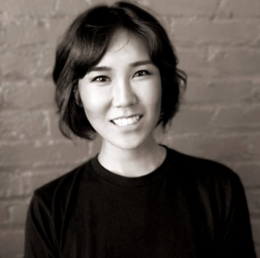
What is BioRender? “Adobe for Science”
Shiz Aoki – cofounder and CEO of BioRender
Education:
B.Sc. In Life Sciences
B.F.A. in Life Drawing/Painting
M.A. in Medical and Biological Illustration
Former lead medical illustrator at National Geographic for 10 years
Founder of Anatomize Studios – graphics company that specializes in medical and scientific art

Slide 5
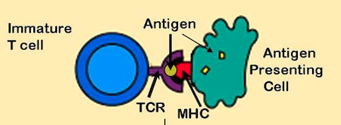
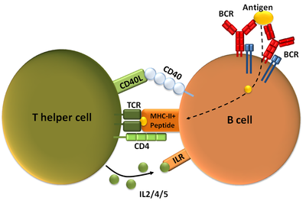
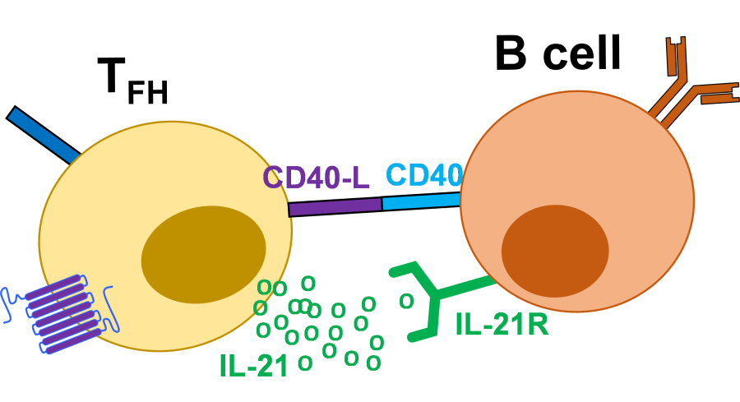
Thoughts on how these different T cells are represented?
Notes:
Different levels and types of information are given

Slide 6
Must be thoughtful in how we communicate & represent our science!
Relevance
Accuracy
Ease of Understanding
Concise
Consistency
Audience
Notes:
Did I forget anything?

Slide 7
Features of BioRender
free and paid subscriptions

Slide 8
Publications – Ensure your research stands out
Create beautiful figures
Professionally designed icons and templates
Hi-resolution figure exports in multiple formats
Share your figure designs with colleagues easily and get feedback
Provides version control as well
Meet publication guidelines
Can download your own license for your figures
Generate image citations
Vast image library

Slide 9
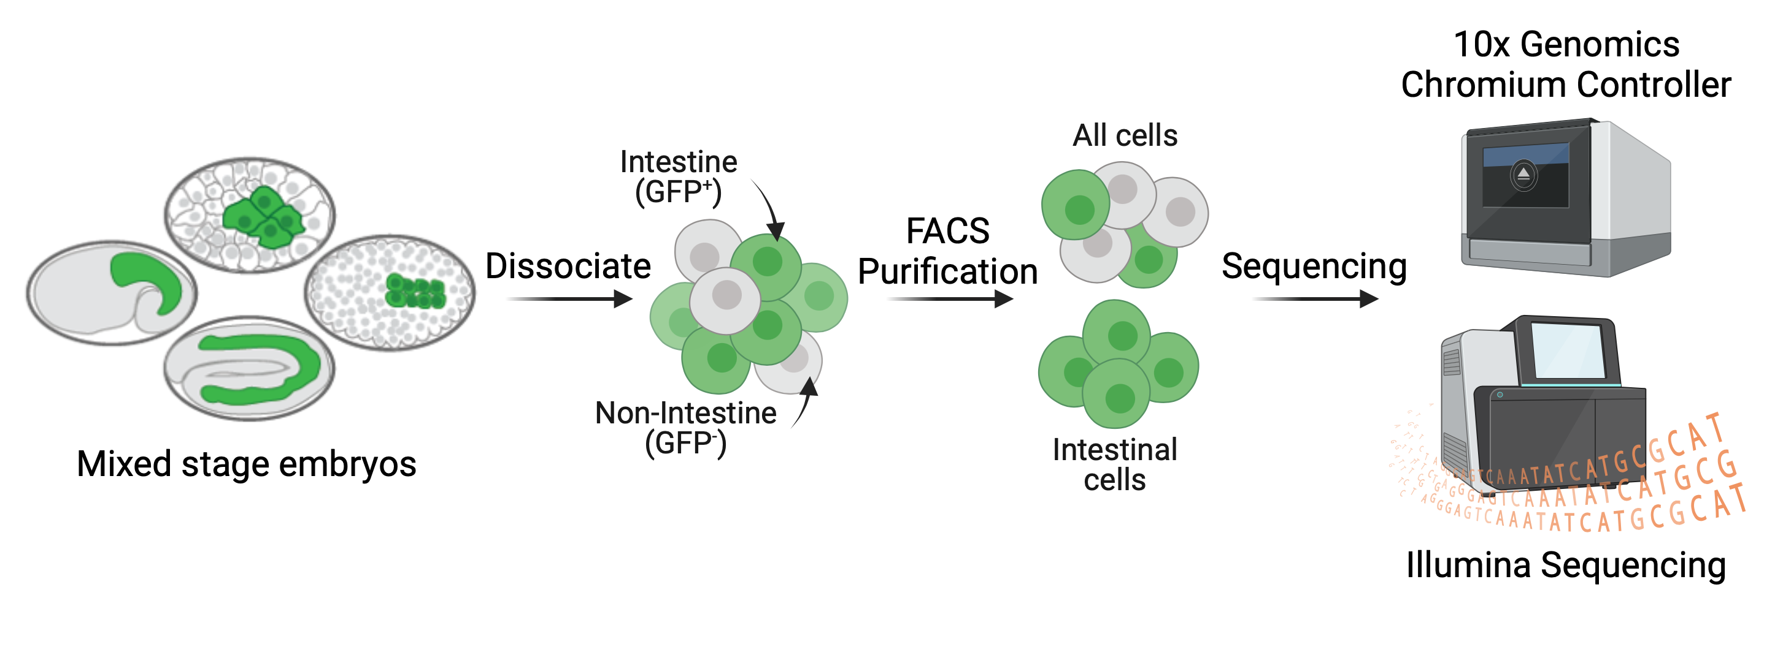
Publications – Example

Slide 10
Presentations – Tell a better story
PowerPoint integration
Get BioRender as an add-in for PowerPoint
Insert figures seamlessly
Need to make a change? Go back to BioRender and edit, then just update the image.
Create beautiful slides
Practice your presentation in BioRender
Can save and export your BioRender slides as a PDF
Make effective science presentations together
Create shared libraries of figures

Slide 11
Presentations – Example
Let’s check out the slides I made

Slide 12
Protocols – Minimize errors at the bench
Visualize your protocols
Various icons/molecules/etc. that can be grouped and reused for consistency
Gridlines and rulers for accuracy and ease
Library of templates to get you started
Onboard effortlessly
Print visual protocols and methods
Common visual language
Maintain version history
Track protocols/methods
Save visual protocols as templates

Slide 13
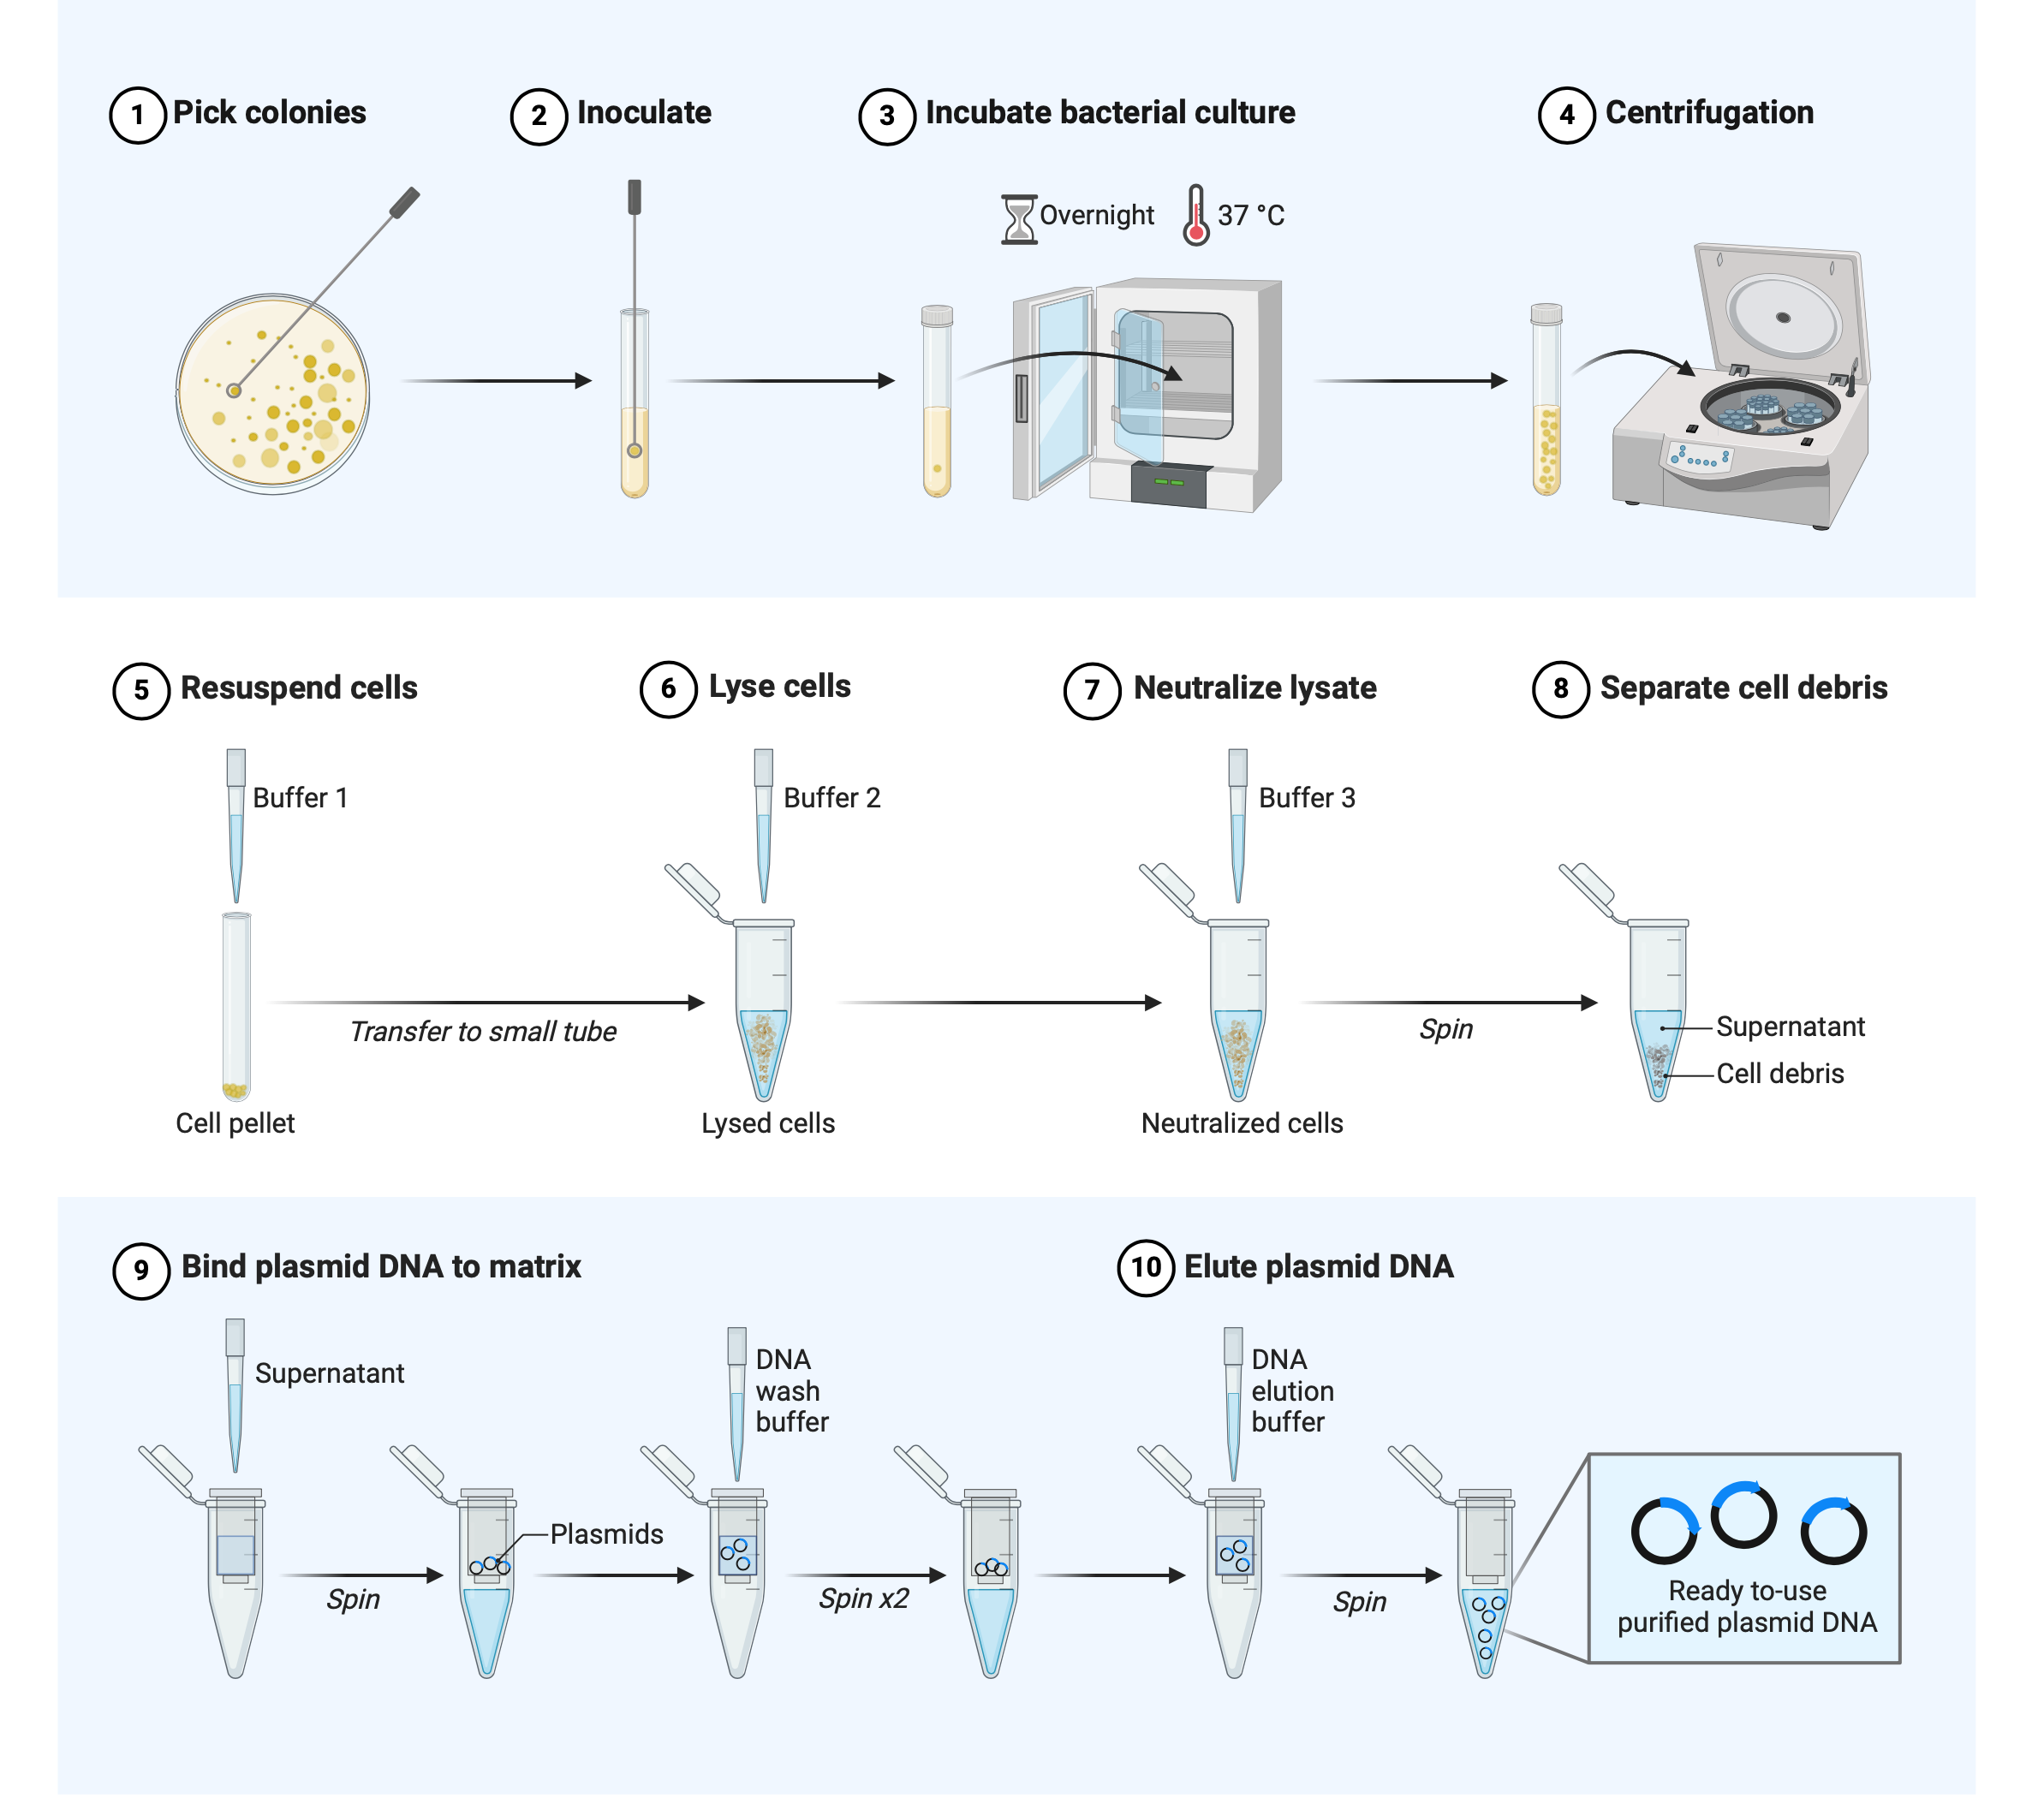
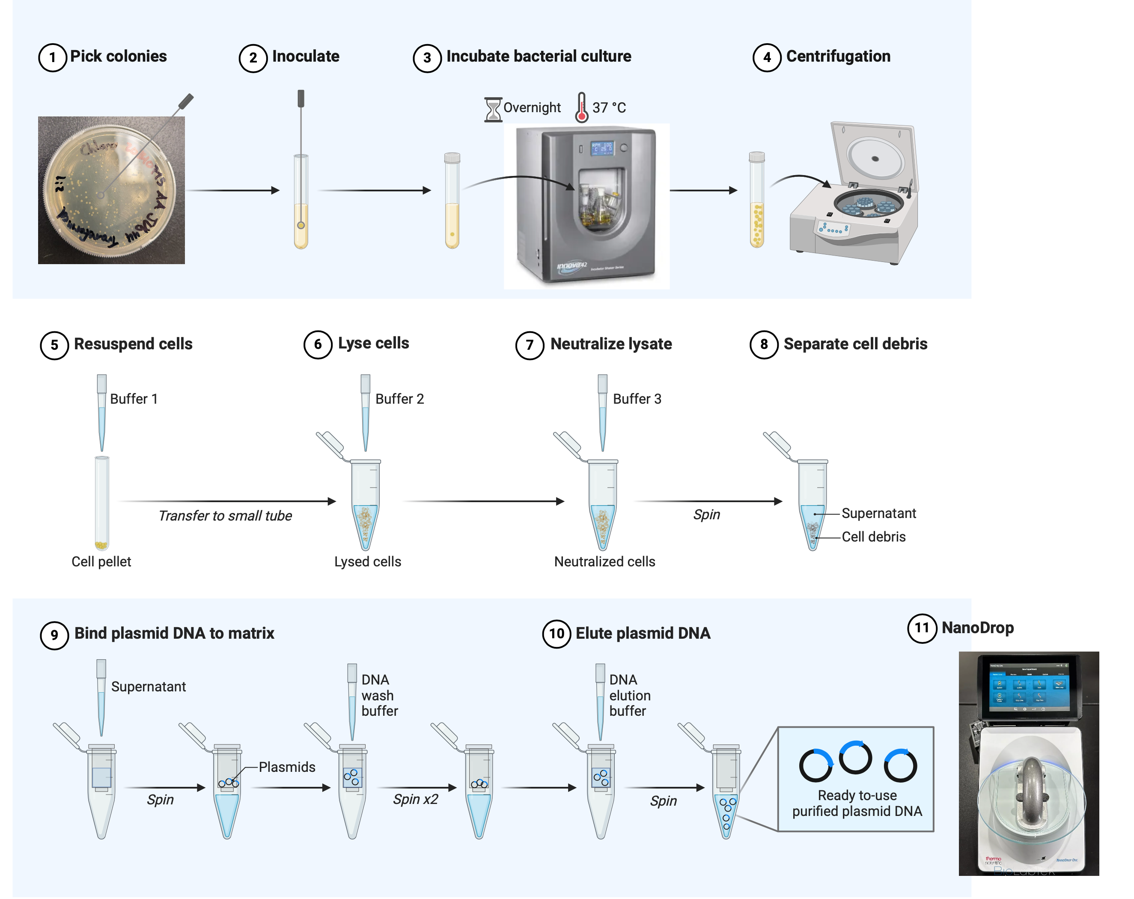
Protocols – Example

Slide 14
Posters – Waste less time resizing and aligning
Start off with a pre-designed and customizable template
Available in different orientations (landscape, portrait, etc.)
Range of color themes
Default font sizes and margins are optimized for printing
Export as high-quality PDF, PNG, or JPG formats
Easy way to build a poster
Drag and drop components
Everything automatically resizes to fit the poster size and maintain consistent margins
Easily modify poster size and contents within
Give and receive feedback within BioRender
Notes:
Pros and cons
- great for simple posters
- Doesn’t give you as much creative design from a layout perspective on more complex posters

Slide 15
Posters – Example

Slide 16
Grant Applications – Create more compelling figures
Don’t start from scratch
Choose from a library of editable templates for common biological pathways, anatomy, or genetics
Use their PDB tool to generate and customize protein structures
Give and receive feedback quickly, or collaborate effortlessly
Export in high-resolution and common formats (PDF, PNG, and JPG)

Slide 17
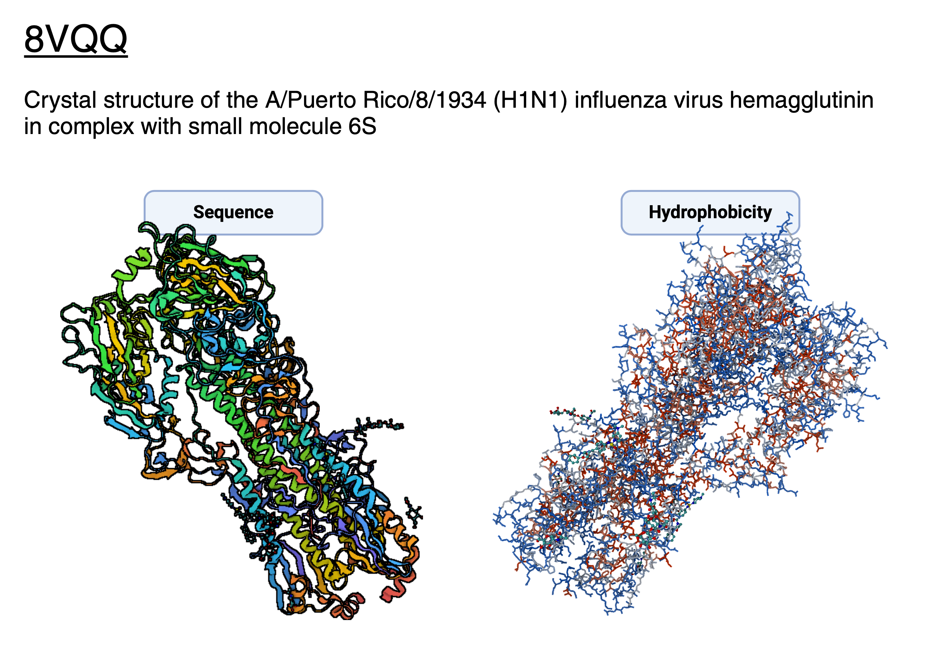
Grant Applications – Example

Slide 18
Brainstorming – Bring your lab together
Collaborative space
Send and manage invitations to your team
Capture feedback in real time
Everything organized in one place
Centralized repo of your team’s files
Search capabilities
Easy to stay organized
Securely send files
Manage access rights with single-sign-on (SSO) and centralized and secure access management
Maintain ownership of your original files with “Send a copy” feature
Apply granular file access for members and groups
Notes:
Single sign-on (SSO) is a cloud security technology that allows users to log in to multiple applications and websites with one set of credentials. SSO works by establishing a trust relationship between an identity provider and a service provider, or application. When a user logs in, the identity provider verifies if they have already been authenticated and sends a token to the service provider to confirm. The user is then granted access to the service.

Slide 19
Graphing – Visualize and analyze your data
Expressive graphs in a click
Paste in your data, BioRender will generate relevant visualization types (column charts, box plots, etc.)
Toggle between display options
Analyze, format, and present
Common analyses are available (i.e., t-test, ANOVAS, etc.)
Tweak graph features for ease of understanding
Combine with figures
Graphs and figures are finally together in one platform
Share graphs and get feedback in real time
Easily add graphs to BioRender illustrations, posters, slides, etc.

Slide 20
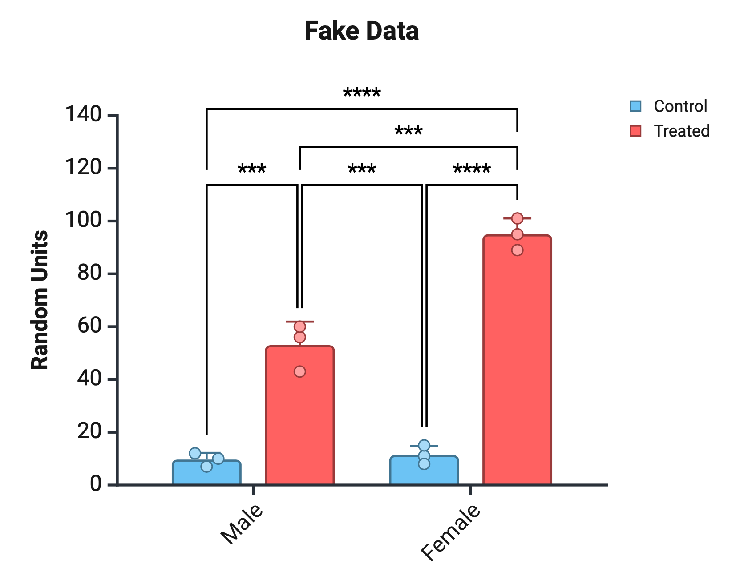
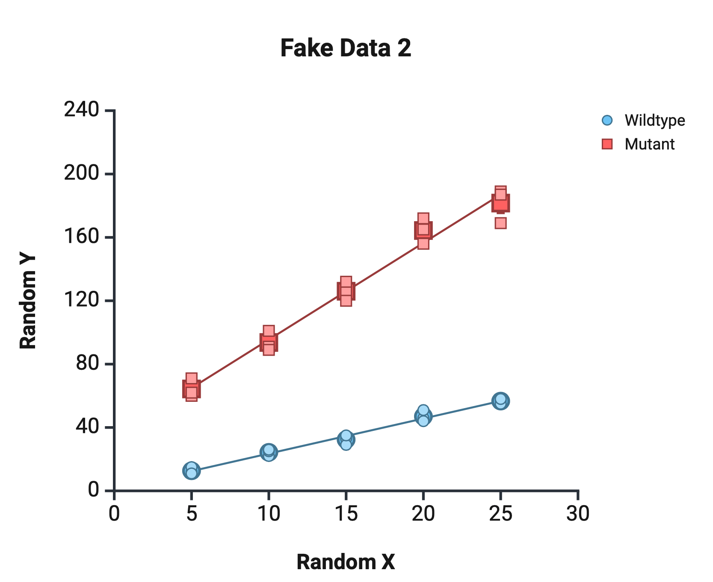
Graphing – Example

Slide 21
Learning resources for BioRender
Learning hub
https://www.biorender.com/learn?utm_source=marketing_site_topnav
Graphical abstracts
https://www.biorender.com/learn/designing-graphical-abstracts
Grants
https://www.biorender.com/learn?category=Grants
Posters
https://www.biorender.com/learn?category=Posters
User guides
https://help.biorender.com/hc/en-gb/categories/18127295627933-How-to-BioRender-guides
https://help.biorender.com/hc/en-gb/articles/17605445332253-Checking-the-contrast-or-legibility-of-a-figure

Slide 22
Final thoughts
Pros
Easy to use
Standardized and accurate image library
Free and paid versions available
Professional graphics development
Collaborative and safe work environment
Cons
Less creative freedom from a design perspective
Complex graphic/poster representations can be challenging
Not suitable for moderate to complex data visualization or analysis
Pay wall

Slide 23
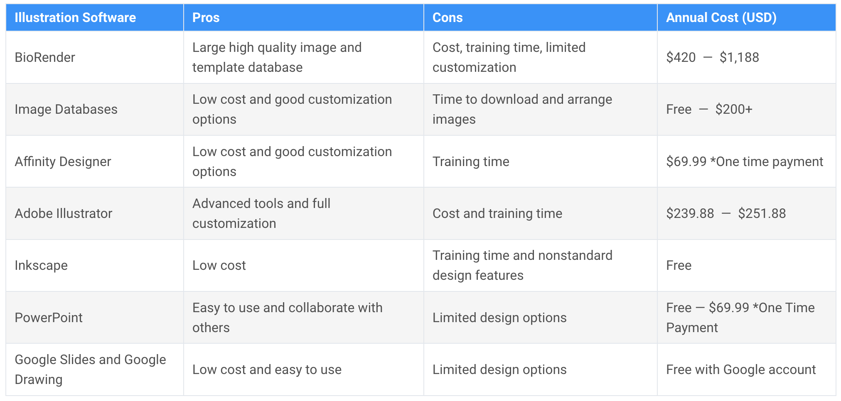
Alternatives to BioRender and more creative freedom
https://www.simplifiedsciencepublishing.com/resources/biorender-alternatives-scientific-illustration-software-comparison
Notes:
I like to use a mix of biorender and adobe illustrator

Slide 24
Questions?

